Slide 1
CARMS Overview
Client Access Request Management System

Slide 2
Key Features
✅ React + Zustand frontend
✅ .NET Core API backend
✅ EF Core with seeding
✅ Swagger docs + Postman
✅ Role-based workflows
✅ Notification & Access API

Slide 3
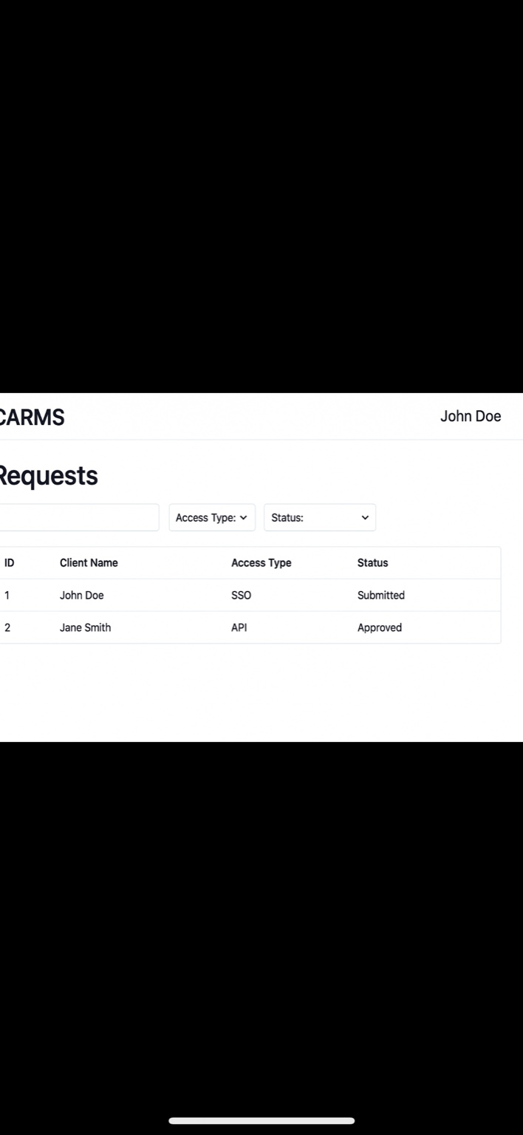
Homepage

Slide 4
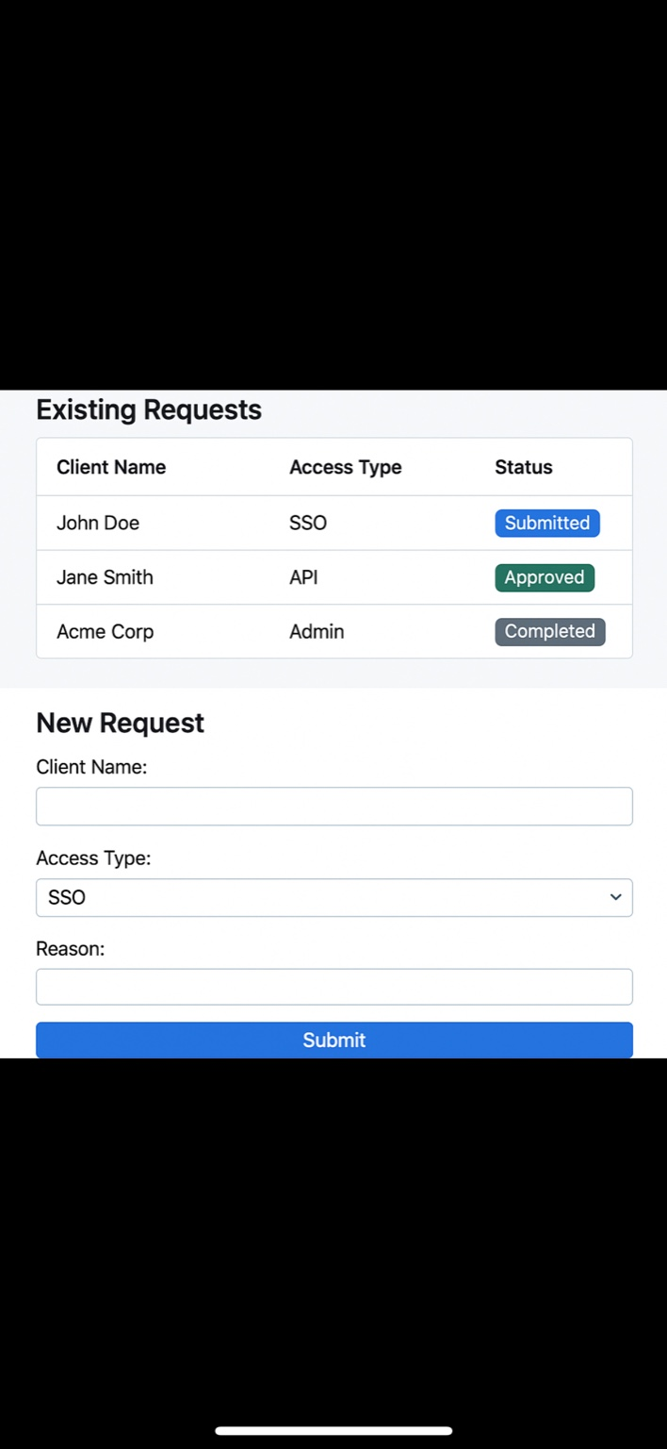
New Request Form

Slide 5
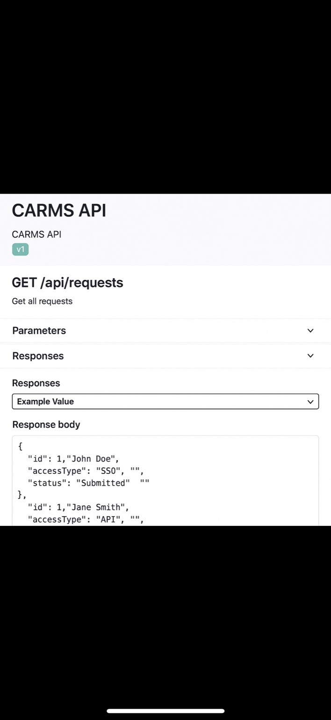
Swagger API Docs

Slide 6
Future Enhancements
🔐 OIDC Auth (Okta/Azure AD)
📊 Role-based dashboards
📝 Audit logs
📫 Email/webhook alerts
🐳 Docker + CI/CD pipeline

